Slide 1

Hidden Curriculum 2026
Presenting your event-study estimates

Slide 2
Four topics
1.) Presenting your equations within the body of your manuscript
2.) Making event-study figures
3.) Other presentation-related items
4.) Practical guidelines on what to show your readers
Behind one beautiful figure is a dozen specification choices

Slide 3
Presenting your equations within the text
Three cases:
(i) You lead with TWFE estimates and then show results from one (or more) of the new estimators (e.g., Sun and Abraham 2021; Callaway and Sant’Anna 2021)
(ii) You lead with results from one of the new estimators
(iii) You show a TWFE equation, but only present estimates from one of the new estimators

Slide 4
Case (i): Lead with TWFE estimates and then show results from one of the new DD estimators
Remains a common approach
Pros:
Present a baseline equation that is straightforward to describe and reference
Takes up minimal space within the “Empirical Strategy” section of your paper
Present a baseline equation that everyone is familiar with
Anyone who runs regressions (i.e., not just economists) can follow along
Cons:
Risk turning off readers who only want to see results from one of the new DD estimators
Big problem when reader is a referee!

Slide 5
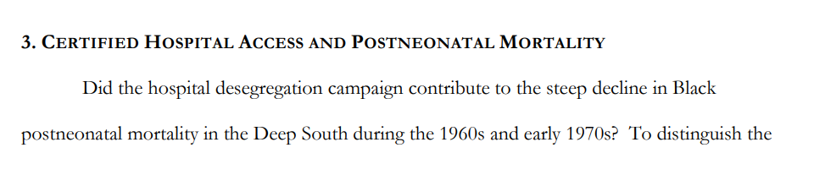
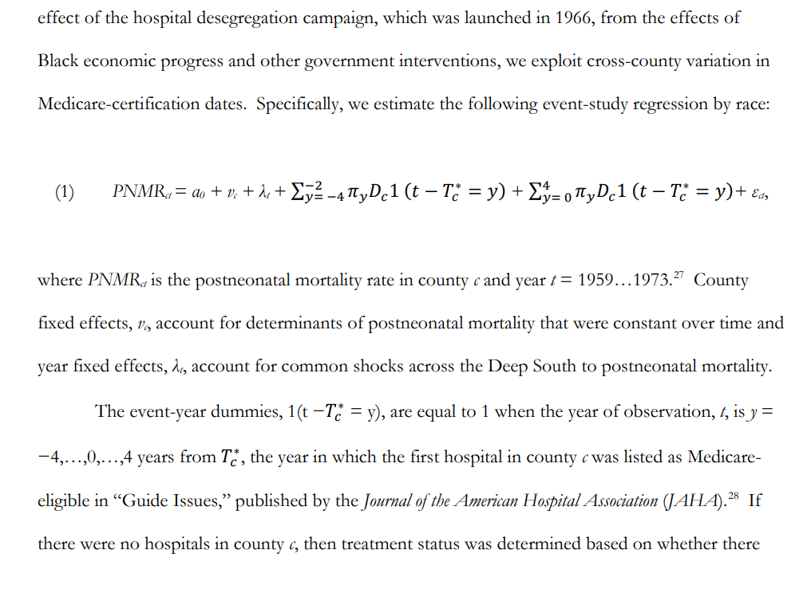
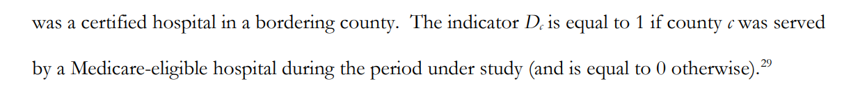
Example of case (i): “Imposing Policy on Reluctant Actors: The Hospital Desegregation Campaign and Black Postneonatal Mortality in the Deep South” by Anderson, Charles and Rees (Forthcoming at Review of Economics and Statistics)
Entire baseline estimation strategy described in less than one page
Easy to refer back to when exploring extensions:
“Including a vector of controls, X_{ct}, on the right-hand side of the estimating equation…”
“In Figure 5, we report event-study estimates based on a modified version of equation (1)…”
Interaction-weighted estimates from Sun and Abraham (2021) are reported later in paper
Because we do not lead with this estimator, we do not have to present the (more complicated and numerous) equations describing this approach

Slide 6
Example of case (ii): “Changes in Family Structure and Welfare Participation Since the 1960s: The Role of Legal Services” by Cunningham and Goodman-Bacon (AEJ: Applied Economics, 2025)
Starting point:
Estimators proposed by Callaway and Sant’Anna (2020) and Sant’Anna and Zhao (2020)
Avoid entirely having to address theoretical issues associated with TWFE
Mention in passing in a footnote
Tradeoff: Baseline strategies require 4 equations and take over 4 pages to discuss
Up to this point, I’ve preferred the approach by Anderson et al. (forthcoming)
Going forward, I’m going to proceed in the manner of Cunningham and Goodman-Bacon (2025)

Slide 7
Example of case (iii)…and what NOT to do!
Recent working paper:
Estimate relationship between state sobriety checkpoint laws and traffic fatalities.
The only equation they present is the following TWFE specification:
The authors never present TWFE estimates in their paper
They only show interaction-weighted estimates from Sun and Abraham (2021)
Poor practice and form
Wrong!
Unfortunately, this happens way too often…

Slide 8
Making event-study figures
Two standard approaches
“Connected”
vs.
“Disconnected”
See Scott’s substack on this:
https://causalinf.substack.com/p/data-visualization-and-the-event
-I’m happily stealing from this in what follows…

Slide 9
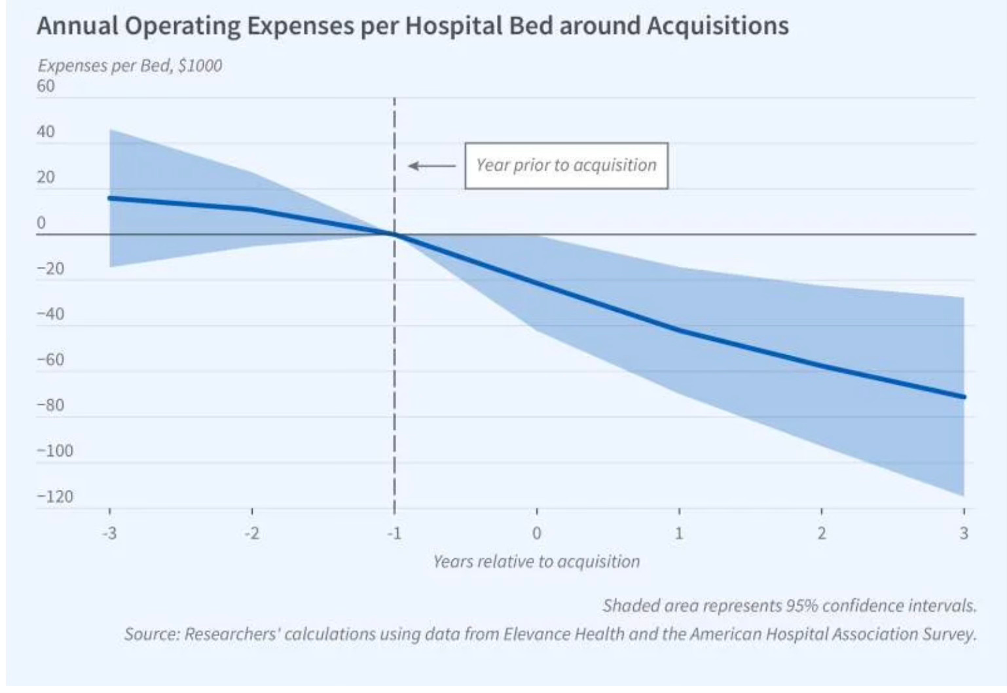
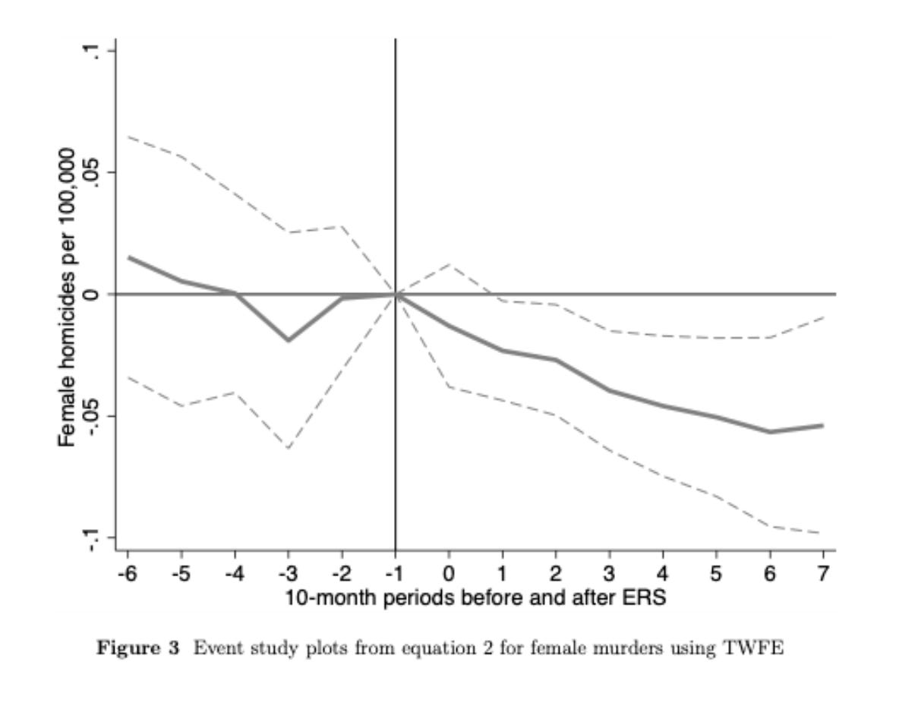
“Connected” (aka bow-tie) event-study figures
Figures taken from Scott’s substack on “Visualizing your event study plot”

Slide 10
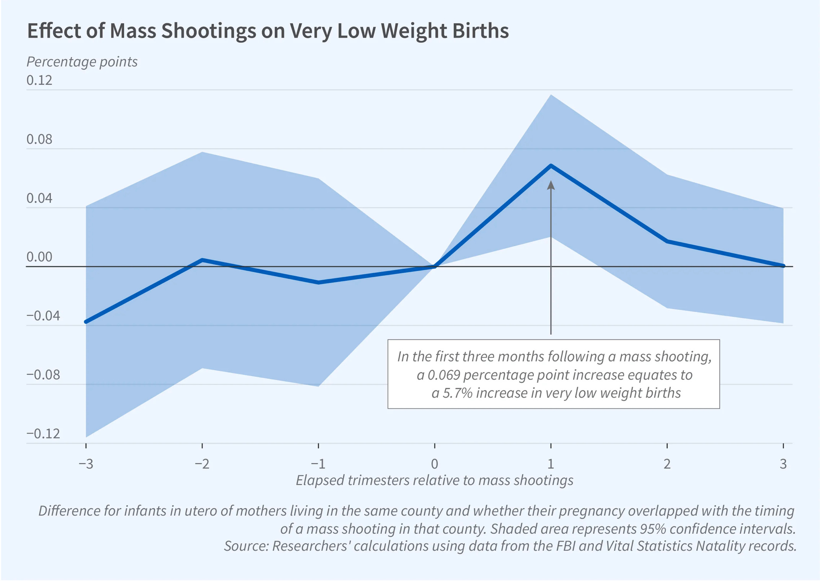
“Connected” (aka bow-tie) event-study figures
I dislike this style of event study
Optical illusion #1: More point estimates than were actually estimated
Optical illusion #2: Tighter confidence intervals around omitted category
If you asked a layperson about this portion of the figure, what would they say?
They would have no idea that this is just an artifact of connecting dots between estimates at t = -1 and t = 0 (or between t = 0 and t = 1), where the CIs are equal to zero at the omitted category (i.e., at t = 0).
Optical illusion #3: Quick glance at CIs and you can almost fool yourself there are pre-trends
Just not very aesthetically pleasing in general
Figure taken from Scott’s substack on “Visualizing your event study plot”

Slide 11
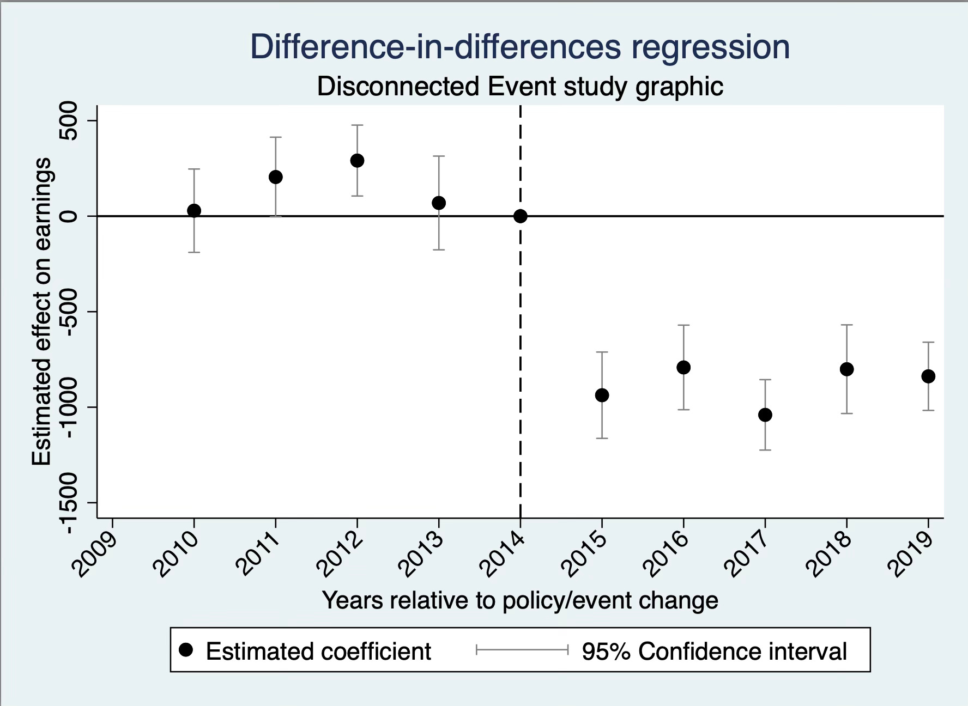
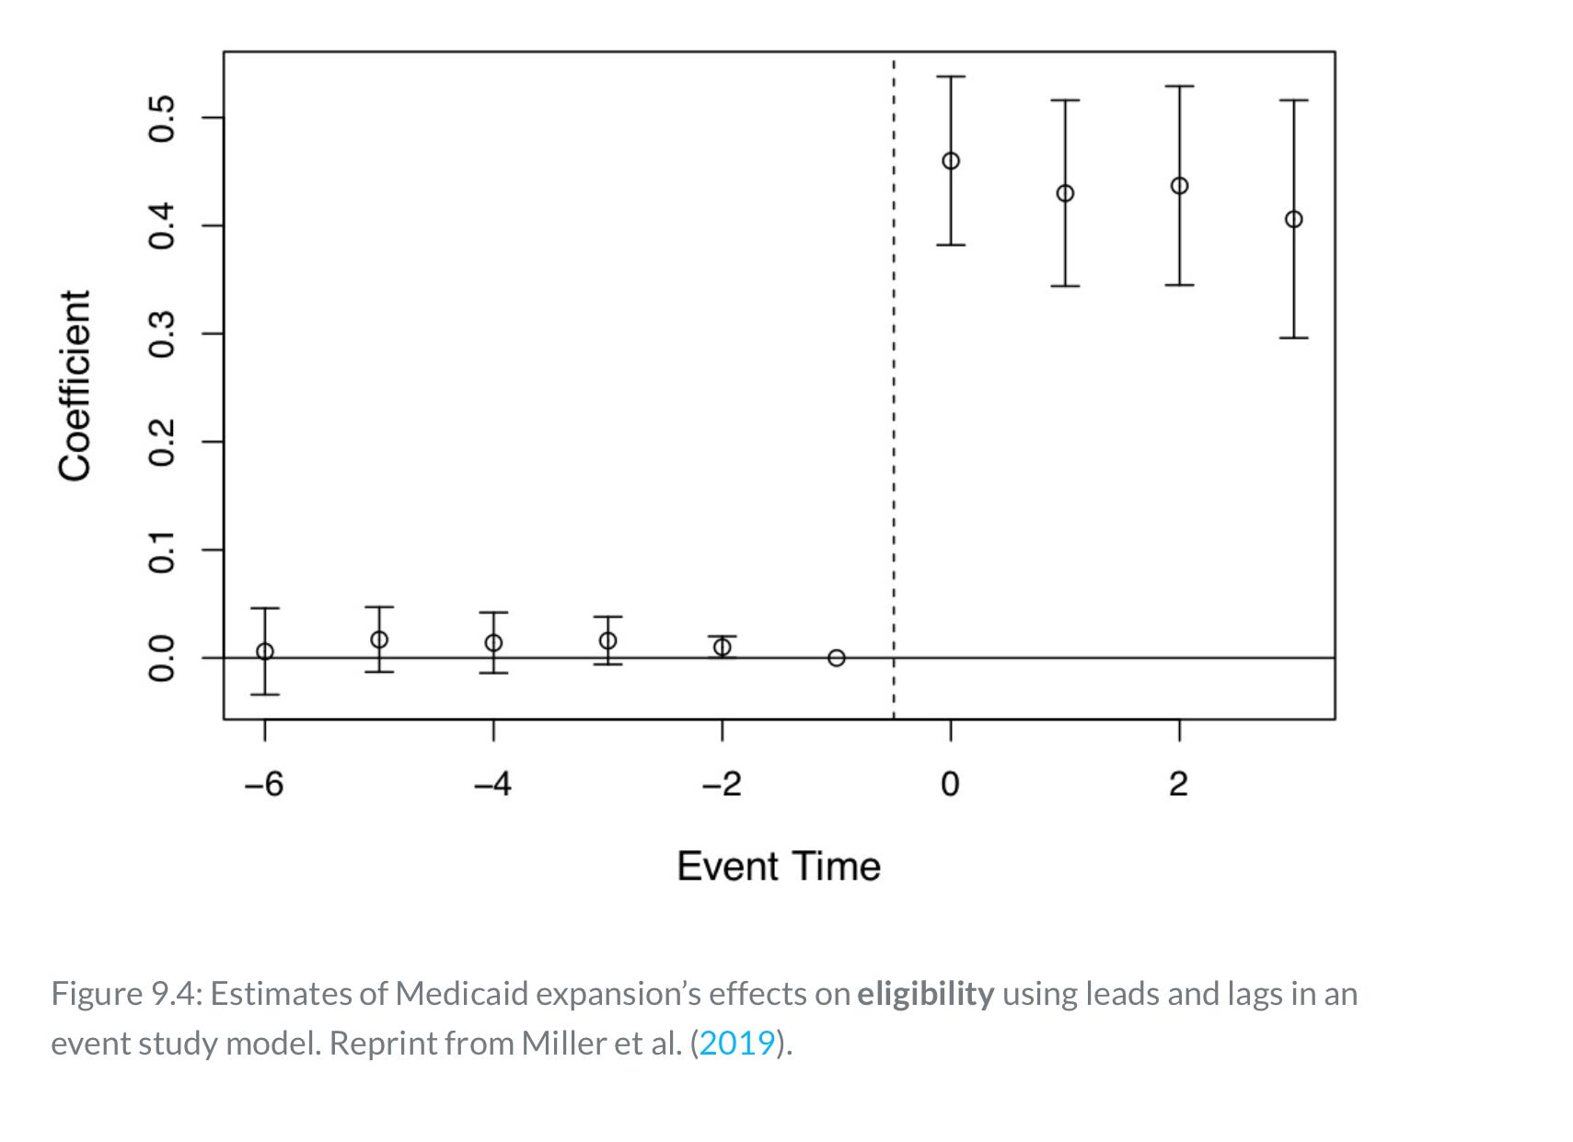
“Disconnected” event-study figures
Figures taken from Scott’s substack on “Visualizing your event study plot”

Slide 12
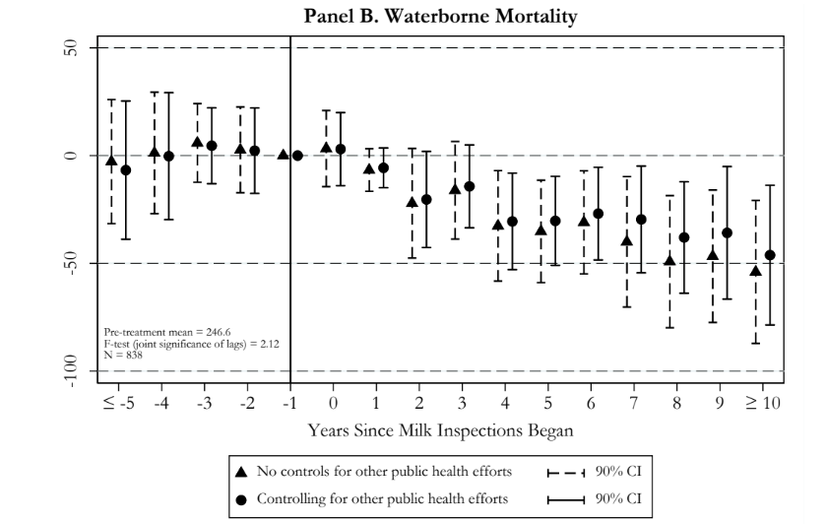
“Disconnected” event-study figures
Does not suffer from the optical illusions present in the bow-tie-style figures
No illusion that point estimates exist across some continuous space
No “pinching” of the CIs on either side of the omitted category
Clean and pretty!
Figure from Anderson et al. (forthcoming Journal of Human Resources)

Slide 13
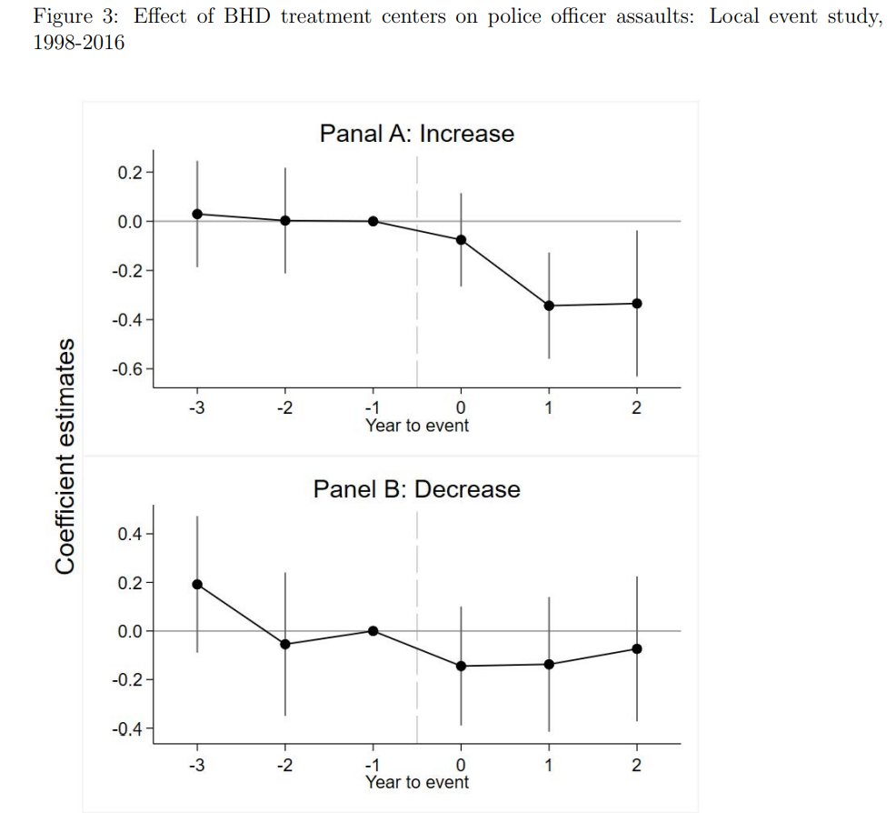
Hybrid approach?
Better than the bow-tie approach
But why connect the dots?
Figure from Deza et al. (forthcoming Journal of Human Resources)

Slide 14
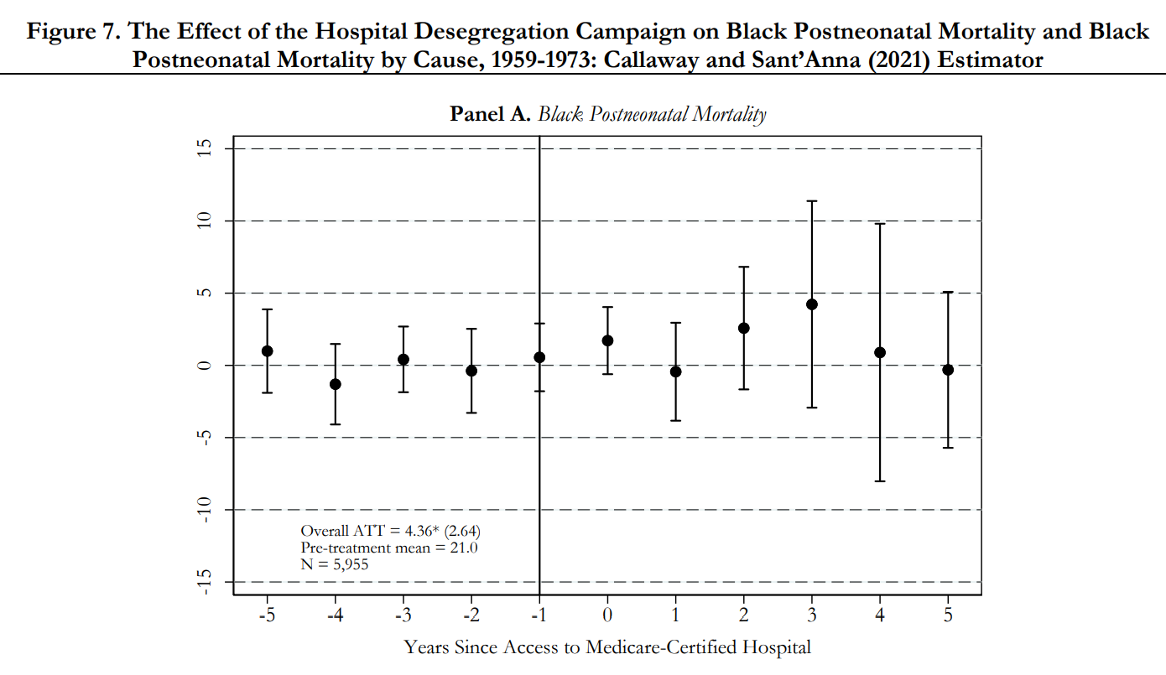
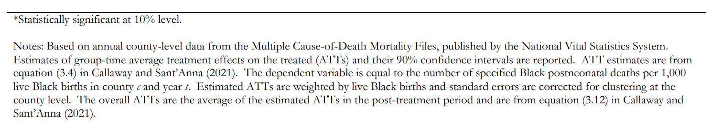
More on event-study figures: Providing important information
Use white space to present additional information
Just like you would with a table, make sure your notes allow the figure to “stand alone”
Do not make your reader wade back through the manuscript to figure out what they are looking at
Figure from Anderson et al. (forthcoming, Review of Economics and Statistics)
Panels B and C of figure omitted for brevity

Slide 15
More on event-study figures: Providing important information
You can even provide important institutional details in the white space of your event-study figures

Slide 16
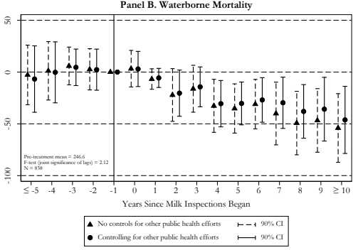
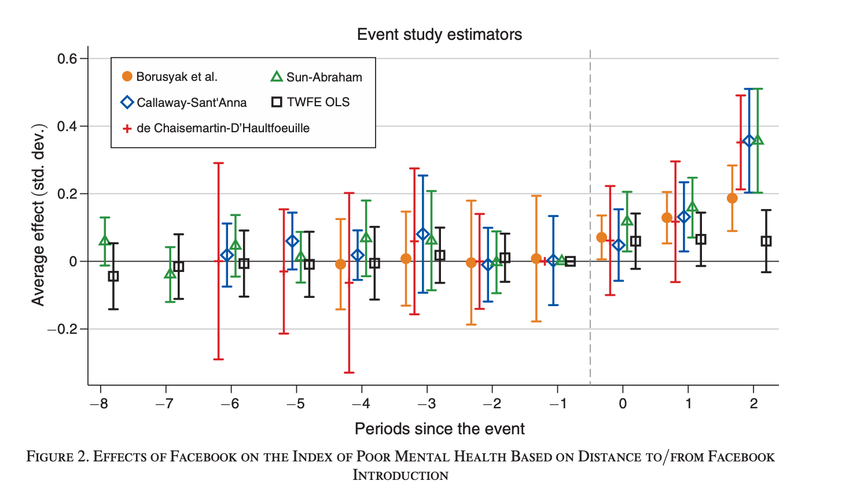
More on event-study figures: Keep it nice and neat
I never present over two sets of estimates in any one figure
Avoid clutter!
I’m not a fan of this…
Figure from Braghieri et al. (2022, American Economic Review)

Slide 17
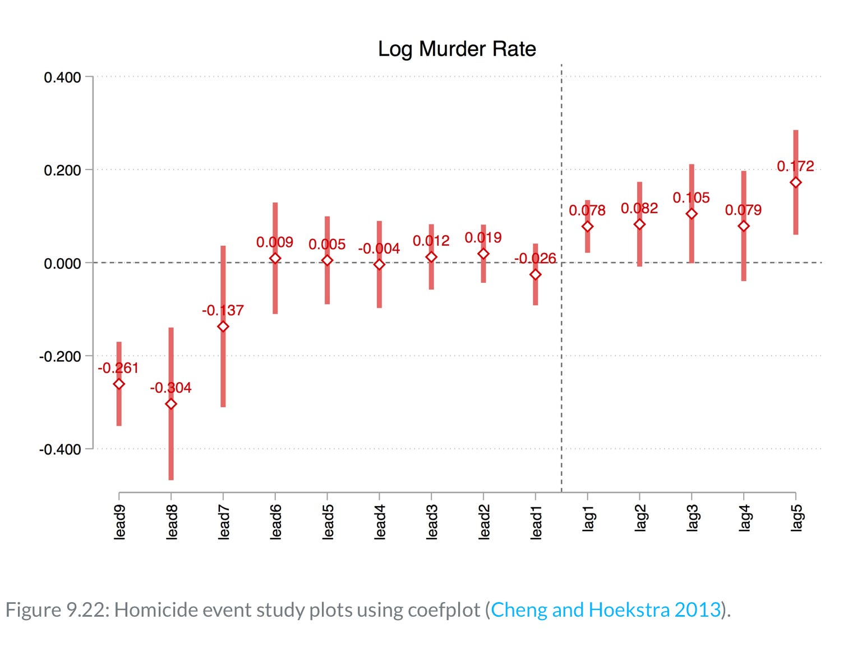
More on event-study figures: Showing values of coefficient estimates
What if I want to report the exact coefficient estimates from my event study?
One option…
I’m not sold on appearance
Figure taken from Scott’s substack on “Visualizing your event study plot”

Slide 18
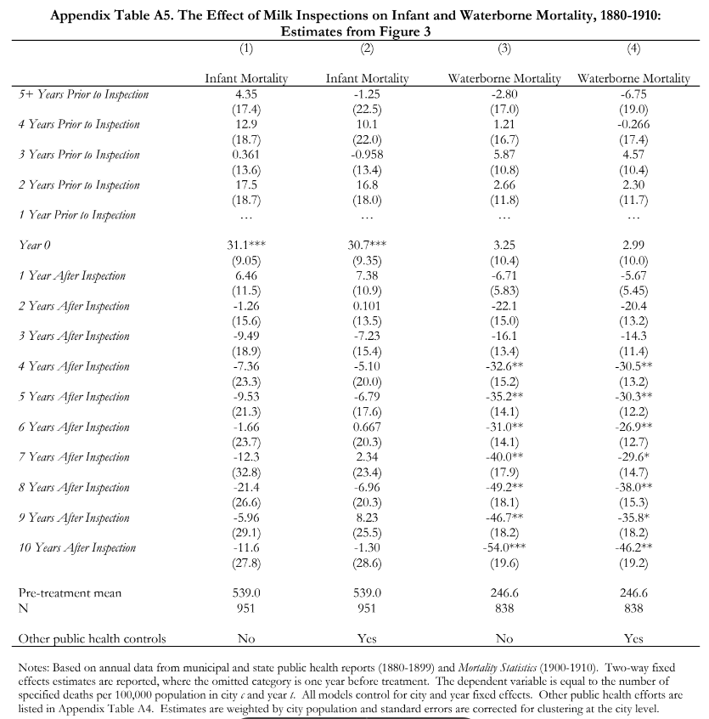
More on event-study figures: Showing values of coefficient estimates
Another option is to include an appendix table
NOT pretty for a presentation
But perfectly fine in your appendix
Allows for presentation of estimates from more than one specification

Slide 19
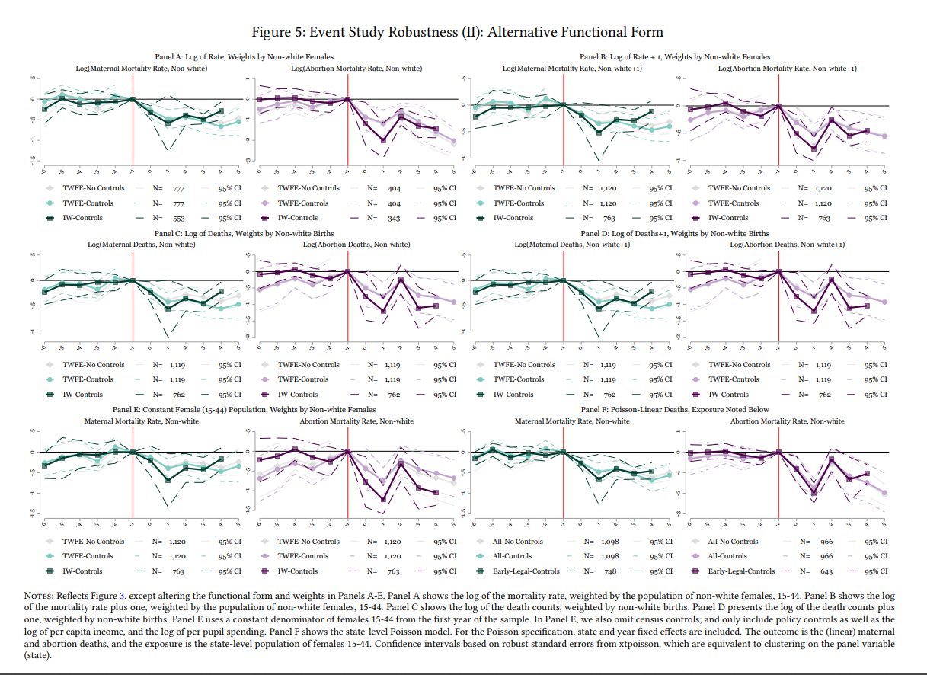
More on event-study figures: Presenting robustness checks
How should I show a bunch of event-study robustness checks?
Error on side of more figures with fewer panels, as opposed to fewer figures with more panels
Here is a place where appendices are your friend!
You do not want a figure that looks like this…

Slide 20
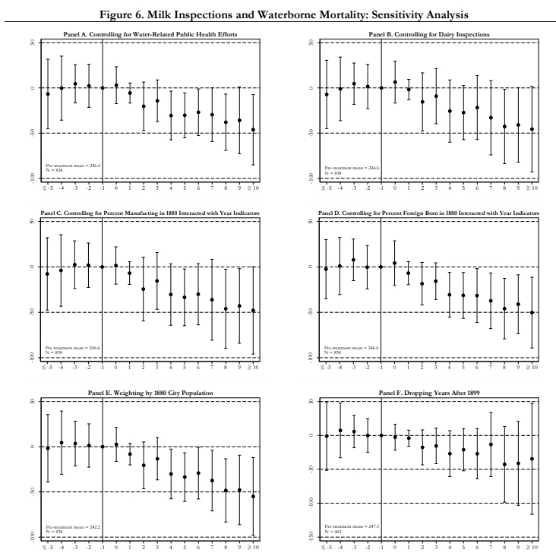
More on event-study figures: Presenting robustness checks
This looks much better! (Not for a presentation but for your paper)
Place less important robustness checks in appendices to avoid clutter
It may not be necessary to present some robustness checks at all…just mention them in a footnote
It is ok for a figure with multiple panels to span more than one page in your document
Do not make reader squint or zoom way in!
Figure from Anderson et al. (forthcoming)

Slide 21
A few best-practice recommendations (theme: transparency)
Best practice should be to increase transparency through bringing clarity about the specification decisions made and to discuss robustness to alternative decisions
-Doug Miller (2023, “An Introductory Guide to Event Study Models,” JEP)
Follow the three Ds!
Decide
Make every specification choice deliberately
At every decision point, ask: Which option better fits this thought experiment?
Document
Write down what you chose and why – in the paper, not just the do file
AI makes this super easy…just create a living document that Claude is constantly updating
Defend
Show the result survives the alternatives – different windows, references, estimators, etc.
Discuss
Does your result survive reasonable changes to the baseline specification? If not, what are the reasons?

Slide 22
A few best-practice recommendations (theme: transparency)
Checklist (items I engage with on every event-study-based paper I write)
Data structure
Units by event time
Picking your reference period and event window
Pre-trends as a diagnostic tool

Slide 23
Diagnose your data structure
Write one sentence telling your reader which DD world you live in
Textbook 2x2 DD setting
Some units get treated, all at the same time
Timing-based (staggered)
Everyone gets treated eventually, but at different times
No never-treated controls
Hybrid (staggered)
Some never-treated units + varying event dates
This information belongs in the introduction of your paper

Slide 24
Units by event time
Coefficients far from t = 0 are almost always estimated off a smaller set of units
If composition is changing as you move along the x-axis, your reader needs to know this
Include a figure like this in an appendix
Unit count by event time

Slide 25
Picking your reference period and event window
Profession standard: Drop the t = -1 dummy and move on
Pro: It is the profession standard!
Con: Your entire path is normalized to one (possibly noisy) period right before treatment
Con: What if there is a “pre-event” process that is bundled with the event (e.g., Ashenfelter dip)? Do not want to use the period of the dip as our counterfactual baseline.
Miller’s (2023) recommendations
First, make a judgement call as to what is a reasonable pre-event window
No hard-and-fast rule
Use institutional knowledge (e.g., Does it make sense to look 20 years prior to policy X?)
What pre-event window would you use for a simple DD model? Why?
For reference period, normalize to zero over several pre-event times
Can get smaller SEs…no longer absorbing noise of one solitary reference period into every other coefficient
Pre-trend reads differently…looking at overall trend in coefficients, not each one’s distance from zero.

Slide 26
Pre-trends as a diagnostic tool
Estimated pre-treatment terms often serve as a tool for diagnosing trends
Often done informally by visually inspecting the graph of the pre-event coefficient estimates
First question: How many pre-period events is “enough” to detect a trend?
A flat pre-trend with two periods proves almost nothing
Low power can hide real trends
Wide CIs around pre-event coefficient estimates near zero ≠ no pre-trend
Even mild, visually-undetectable trends can move post-event estimates a lot
Consider adding something like the Roth (2022) power test.
It asks: “Given the pretrends I observe in my data, how large would a trend violation need to be for me to detect it?
Key insight: Test quantifies what magnitude of violations you could plausibly miss
Helps researchers understand whether their “clean” pretrends provide meaningful evidence for their identifying assumption.

Slide 27
Consider the following event-study graphs
LOW POWER
LOW POWER
Anderson et al. (JHR, forthcoming)
Miller et al. (QJE, 2021)

Slide 28
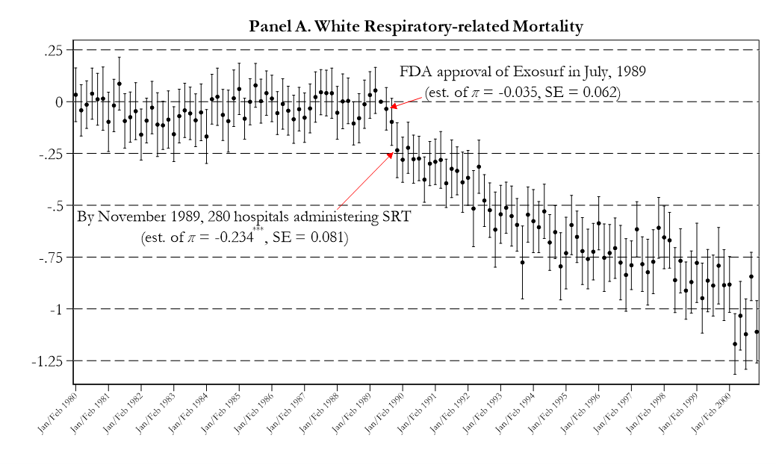

Anderson, Charles, and Rees (NBER WP)

Slide 29
Other items I frequently engage with
How should I handle the endpoints? Bin them? Show all?
Should I pool my event-study indicators?
Covariates (don’t ask me…ask Scott!)
Weighting
More generally, at the end of each project,…
you’ve convinced yourself of what the data are telling you through exhaustive exploration; the figures you publish should reflect that conviction faithfully, not selectively showcase the most flattering moments from your journey.

Slide 30
Conclusion
Take pride in the appearance of your results
Event-study figures help tell the story of your paper!
Sloppy presentation of results can sink a paper
Think of creating tables and figures as an art form…take the time to do this right
Be transparent about your specification choices and why they matter

